Slide 1
Copyright/ Fair Use for Teachers
What, when, and how of using copyrighted materials in the classroom

Slide 2
Factors considered for fair use
(1) the purpose and character of the use, including whether such use is of a commercial nature or is for nonprofit educational purposes;
(2) the nature of the copyrighted work;
(3) the amount and substantiality of the portion used in relation to the copyrighted work as a whole; and
(4) the effect of the use upon the potential market for or value of the copyrighted work.
United States Copyright Office, Reproduction of Copyrighted Works by Educators and Librarians, 2009
Notes:
When using copyrighted work, ask yourself “What am doing with this?”, “Is this already in the public domain, or does it have current copyright protection?”, “How much of this am I using?”, and “Am I infringing on profit-making from this piece?”

Slide 3
Print Materials
Allowable
Poems of less than 250 words
1000 word excerpt, or 10% rule for longer passages
One illustration per book or periodical
A chapter from a book
An article from a periodical
Two pages of a “special work” that combines text with graphics (10% rule still applies)
Not allowed
Consumable texts (workbooks, test booklets, answer sheets)
Creating your own anthology
To replace the purchase of text
Charging students more than the cost of copying
Copying for use by more than one school course
No more than one short piece, or two excerpts, from the same author in a term
No more than 9 occurrences of multiple copying per class, per term
United States Copyright Office, Reproduction of Copyrighted Works by Educators and Librarians, 2009
Notes:
Multiple copies for classroom use may be made….with restrictions. (Note red text!) When using copyrighted materials, even in fair use, it is important to post the copyright notice with the copied work.

Slide 4
Video
Allowable
Classroom viewing to supplement the curriculum
Streaming from the media center to the classroom
Using portions of copyrighted works, following the 10% rule or less than three minutes of the whole, in media productions
Making copies, to be held in the library, for use if the original is unusable (but it must be repurchased, if possible, ASAP)
Not allowed
Viewing as entertainment
Use in distance learning
Streaming copyrighted video for student use from home
Posting teacher or student multimedia presentations that use copyrighted works to a website
Use of “bootlegged” copies
American Library Association. (2009). Performance of or showing films in the classroom.
Technology and Learning. (2005). Copyright and Fair Use Guidelines for Teachers.
Notes:
Our district has its own guidelines for video use. If in doubt, try to use the streaming video services through the district/ campus online resources—they’ve already been pre-approved!

Slide 5
Music
Allowable
Print music follows similar guidelines as print materials
Copying print music for “emergency” purposes for performance; copies must be purchased ASAP
Single copies of recorded student performances for the teacher
Single copies of purchased copyrighted recordings for classroom use
30 seconds of a musical piece
Not allowed
Copying music to make a compilation
Copying print music from a consumable source
Public performance of whole copyrighted works without permission
United States Copyright Office. (2009) Reproduction of Copyrighted Works by Educators and Librarians.
Technology and Learning. (2005). Copyright and Fair Use Guidelines for Teachers.
Notes:
Supposedly, playing music in the classroom is also prohibited…discussion?

Slide 6
Digital content
Allowable
Downloading images for educational use
Use of video and sound files from the Internet, following the video and music guidelines
Not allowed
Reposting the content to the Internet without permission
Posting “bootlegged” material
Technology and Learning. (2005). Copyright and Fair Use Guidelines for Teachers.
Notes:
Follow the four fair use guidelines, and stick to classroom use only. If multimedia projects are to be posted, be sure to obtain permission from copyright owners and display citations.

Slide 7
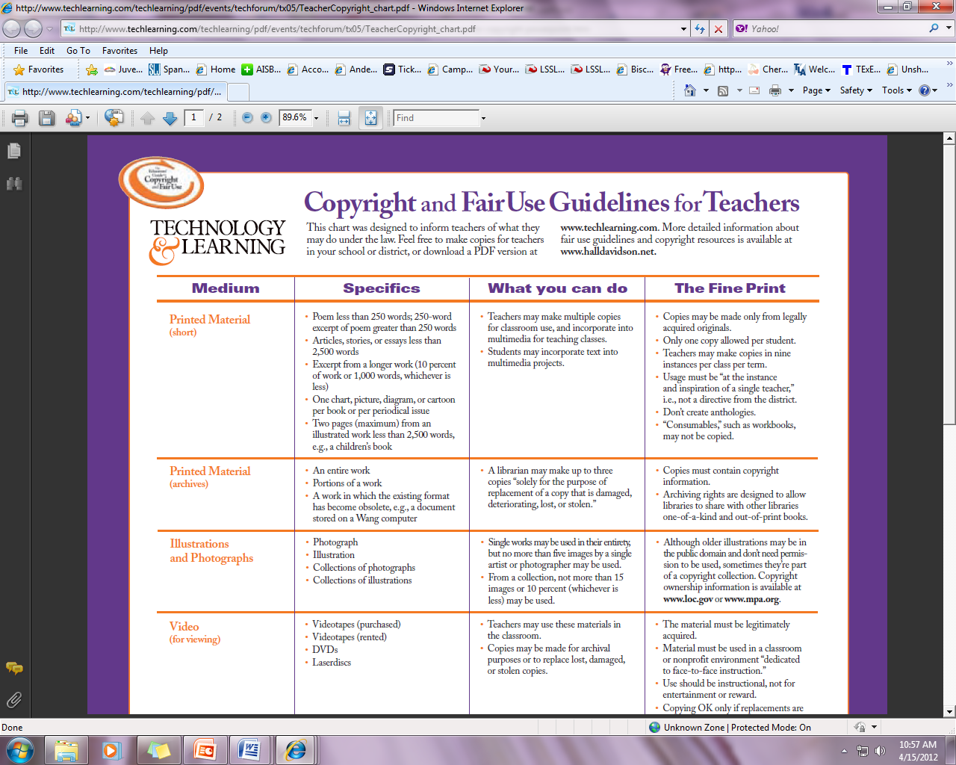
A very handy guide!
http://www.techlearning.com/techlearning/pdf/events/techforum/tx05/TeacherCopyright_chart.pdf
Notes:
Note the permission to download and copy for teachers!

Slide 8
Additional resources
A Fair Use evaluation tool, developed by Michael Brewer & ALA Office for Information Technology Policy, that allows you to document your fair use for record-keeping: http://librarycopyright.net/fairuse/
Tech & Learning articles on copyright, including lessons for students: http://www.techlearning.com/section/Copyright/31/page/1
Fair Use checklist, from Columbia University Libraries: http://copyright.columbia.edu/copyright/fair-use/fair-use-checklist/
An interactive “Copyright Navigator” by Lionel S. Sobel, Professor, Southwestern University School of Law Editor: http://navigator.carolon.net/
Notes:
These resources include lessons to use with students and more information for teachers and librarians.

Slide 9
Credits
American Library Association. (2009). Performance of or showing films in the classroom. Retrieved 3/19/12 from http://www.ala.org/advocacy/sites/ala.org.advocacy/files/content/copyright/fairuse/digitalclassroomdelivery/webdigitalpsafinal.pdf
Technology and Learning. (2005). Copyright and Fair Use Guidelines for Teachers. Retrieved 3/19/12 from http://www.techlearning.com/techlearning/pdf/events/techforum/tx05/TeacherCopyright_chart.pdf
U.S. Copyright Office. (2009). Reproduction of copyrighted works by educators and librarians. Retrieved 4/11/12 from http://www.copyright.gov/circs/circ21.pdf

